Slide 1
VueJS Basics and Vue CLI 3
Workshop by BorisNekezov

Slide 2
1. Who am I?
My name is Boris Nekezov
I work as Front-End developer in Trio Interactive
I have more than 4 years professional experience as one
Github: boris-nekezov

Slide 3
2. What is VueJS?
VueJS is a powerfull Front-End framework
Official site: vuejs.org
GitHub: github.com/vuejs/vue
VueJS allows you to create everything:
Small widgets driven by JavaScript which you drop into existing applications
Medium size applications where you control the whole page through JavaScript and rerender various parts making it very reactive
Big enterprise level single page applications
What is a single page application?
Single page applications have only one page index.html
When navigate is looks like you go through many different pages but actually it just loads dynamically other components
The page doesn’t reload at any point, although url can be updated to provide perception and navigability of separate logical pages in the application

Slide 4
3. History of VueJS
Vue was created by Evan You after working for Google using AngularJS in a number of projects.
He later said about his work on Vue: “I figured, what if I could just extract the part that I really liked about Angular and build something really lightweight”
Vue was originally released in February 2014.

Slide 5
4. The Future of VueJS
Maja Nowak December 19, 2018:
“With over 120k stars on GitHub, Vue.js is currently the trendiest JavaScript front-end framework, beating Angular and React in GitHub star count by a fair margin.”
“Vue might have started as a small project driven by developer needs of its creator, Evan You, but it has matured considerably over the years—becoming a full-fledged framework with a grownup ecosystem and developer tooling. Along the way, Vue attracted a decent number of contributors, sponsors, and evangelists.”
Currently at the moment: 30.01.2019
1st place VueJS 126,643
2nd place React 121,074
3rd place Angular 44,823
My conclusion is that VueJS has very bright future and will take a decent place among the other giants Angular and React.

Slide 6
5. Why choose VueJS over ANGULAR and REACT? Part 1
VueJS is extremely lean and small
16kb minified and gzipped for the core framework
Even With Vue Router it still stays very lean and small compared to Angular and React
VueJS is faster than Angular and React
It provides fast loading time
It also fast at runtime and with some benchmarks it even beats angular and react
It's very feature rich despites its small size
VueJS is the easiest one to learn
No need to learn TypeScript like Angular
Ne need to learn JSX like React
We do it just with plain JavaScript

Slide 7
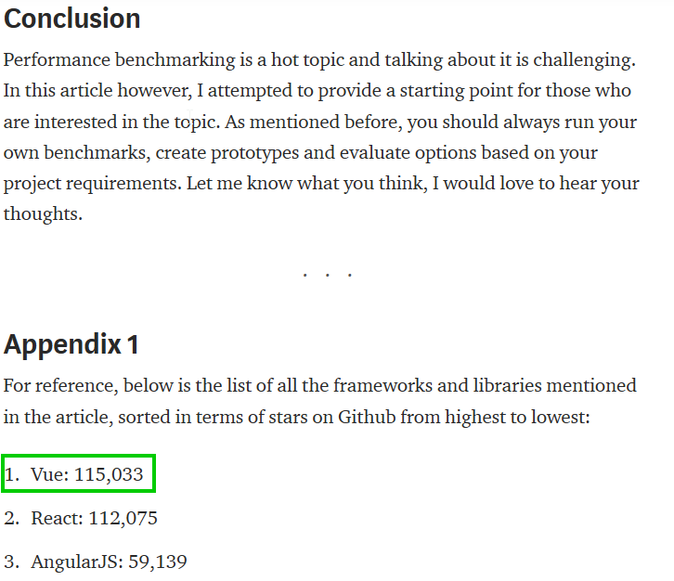
6. JavaScript Frameworks, Performance Comparison
Source:
https://medium.com/@ajmeyghani/javascript-frameworks-performance-comparison-c566d19ab65b

Slide 8
7. What is Vue CLI 3 (CLI stands for Command Line Interface) - cli.vuejs.org/
This is the Standard Tooling for Vue.js Development
It has many features: Babel Support, TypeScript Support, Progressive Web App(PWA) Support, Router, Vuex, CSS Preprocessors, Linter/Formatter, Unit Testing, E2E Testing, Use config files
The power CLI is that you actually can check which feature you want to include in your current project and then you can select even different options of most the features. That makes it extremely flexible whether you want a small app or a large enterprise app.
It has beautiful graphical user interface to create and manage your apps

Slide 9
8. Preparing workflow environment
1. Install Node.js - https://nodejs.org/en/download/
2. Install Git Bash - https://git-scm.com/downloads
3. Vue.js devtools - https://chrome.google.com/webstore/detail/vuejs-devtools/nhdogjmejiglipccpnnnanhbledajbpd
4. Go to Git Bash and install Vue CLI 3 with npm (for yarn you need to install yarn package manager https://yarnpkg.com/en/ )
npm install –g @vue/cli
Yarn add @vue/cli
@vue/cli is a globally installed package and provides the “vue” command in your terminal
You can check if it is installed properly with the following command:
vue --version

Slide 10
9. Create project with terminal + DEMOSTRATION
vue create project-name
WARNING! If you are on Windows using Git Bash with minTTY, the interactive prompts will not work.
You must launch the command as
winpty vue.cmd create project-name
If you however want to still use the vue create hello-world syntax, you can alias the command by adding the following line to your ~/.bashrc file.

Slide 11
9.1 Follow these steps:
1. go to user
cd ~
2. Create .bashrc file
Vim .bashrc
3. Insert the following command
alias vue='winpty vue.cmd’
4. press Esc
5. press :x – to save and exit
6. You will need to restart your Git Bash terminal session to pull in the updated bashrc file.

Slide 12
9.2 Open again git bash
And add the following command:
vue create project-name
After the installations is ready go to project folder
cd project-name
Run development mode with:
npm run serve
Go on your browser:
http://localhost:8080/

Slide 13
10. create project with vue ui + DEMOSTRATION
Open vue User Interface:
vue ui
Go to project manager:
Click More
Click View Project Manager
+ Create
Choose the path to your project
Click + Create a new project here
Name project
Project folder
project-name
Click Next Choose Preset
Create Project
Go to Tasks and click Serve => run task to start builder and watchers
Click open app to go to http://localhost:8080/

Slide 14
11. Install workshop repo from github
Clone my repo about this workshop
git clone https://github.com/boris-nekezov/vuejs-basics.git
Install dependencies
Run builder
Open with editor ir IDE

Slide 15
12. Project Overview
vuejs-basic
node_modules
public
index.html
src
assets
components
appfooter.vue
appheader.vue
appmain.vue
app.vue
main.js
.gitignore
package.json
package-lock.json
readme.md

Slide 16
13. Explaining workshop demo
Index.html
Add div#app
Main.js
Import VueJS and all plugins we need here
Import App.vue
Create Vue instance
App.vue
Template
only one nested element
Script
Import other components
Register components
Explain ES6 syntax
Call components in template
Style
Lang=“scss”
Scoped

Slide 17
13. Explaining workshop demo Part 2
Go to Header.vue
Explaing data
Printing variables in the template
Go to Main
Directives
v-on
v-bind
V-once

